Slide 1
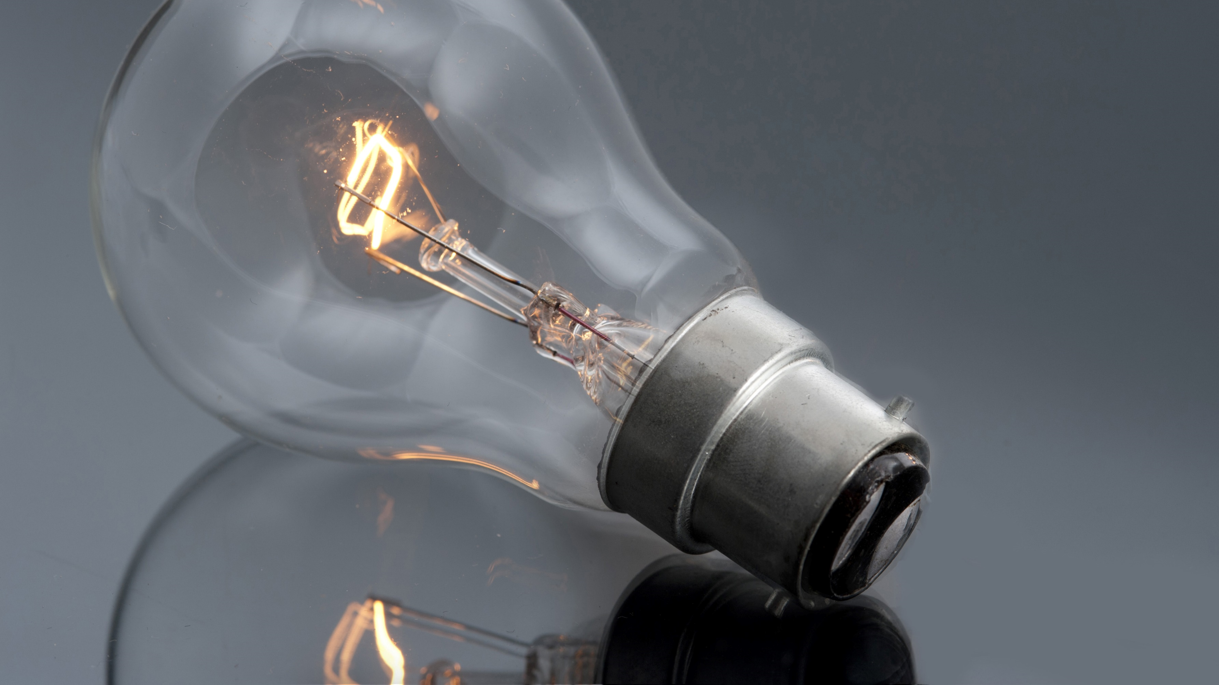
HYDROPOWER ENERGY ELECTRA_2147
TEAM MEMBERS - KASHEENA AND PRATICHEE
DIVISION- CSE B

Slide 2
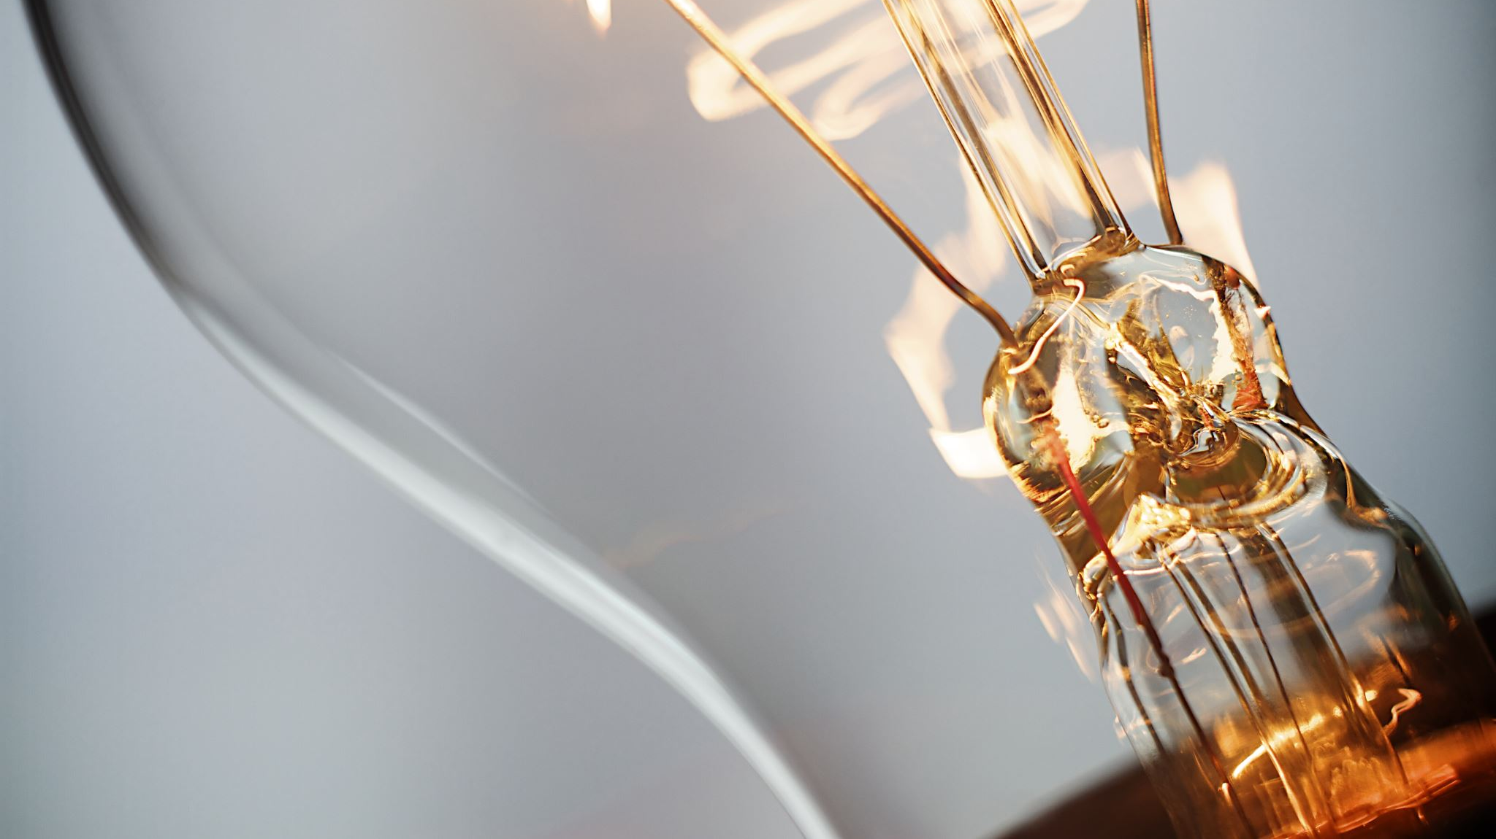
Generating electricity using hydropower energy
Theme: Exploration of a new source and supply
Category: Renewable and affordable energy
Domain Bucket: Renewable energy Team Name : Hydro energy powerplant
Team Leader Name : Kasheena Mulla
Institute/Department: MIT ADT, Pune (SOE)
Division: CSE B

Slide 3
PROBLEM STATEMENT
Yet according to the International Energy Agency, nearly 240 million Indians lacked lack access to electricity in 2017. One out of every five people around the world without access to power lives in India.
According to the 2018 Global Competitiveness Report, India ranks at 80th position among 137 economies in the reliability of its electricity supply, the report added.

Slide 4
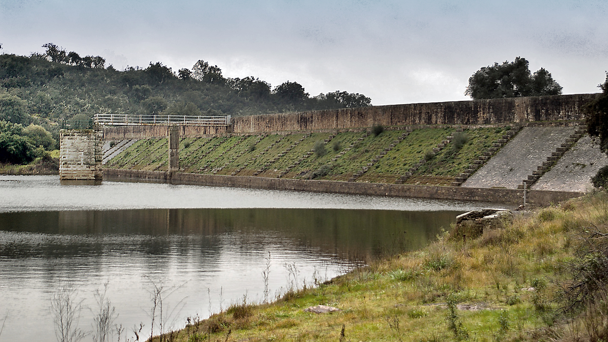
SOLUTION TO THE PROBLEM
Hydroelectricity, or hydroelectric power, is electricity produced from running water.
In 2015, hydropower generated 16.6% of the world's total electricity and 70% of all renewable electricity and was expected to increase by about 3.1% each year for the next 25 years.

Slide 5
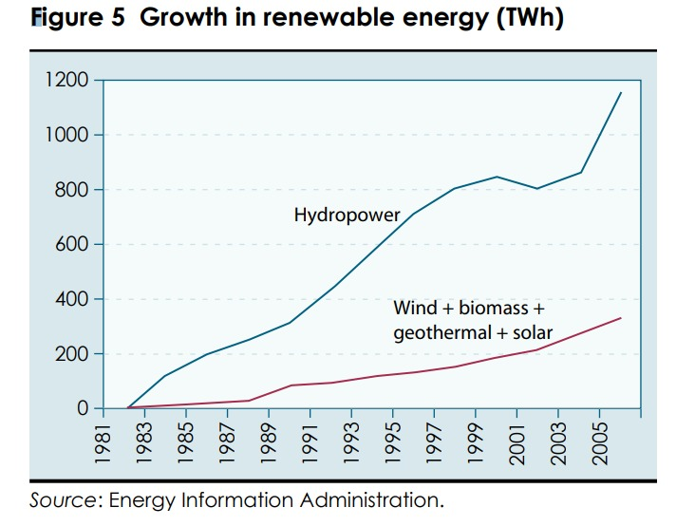
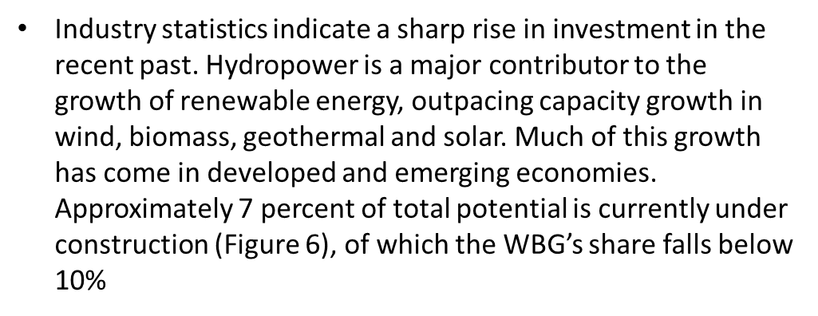
HYDROPOWER VS OTHER RENEWABLE ENERGY

Slide 6
ADVANTAGES AND DISADVANTAGES OF HYDROPOWER
ADVANTAGE
DISADVANTAGE
Renewable
Emission Free
Reliable
Adjustable
Create Lakes
Faster Developed Land
No reservoir required
Impact on Fish
Limited Plant Locations
Higher initial Costs
Carbon and Methane Emissions
Susceptible to Droughts
Flood Risk
Low-power in the summer months

Slide 7

OUR PROPOSAL:
“Cooperation of Hydroelectricity in smart cooperative housing societies”

Slide 8
Suitable Conditions for Micro Hydro Power Plants

Slide 9
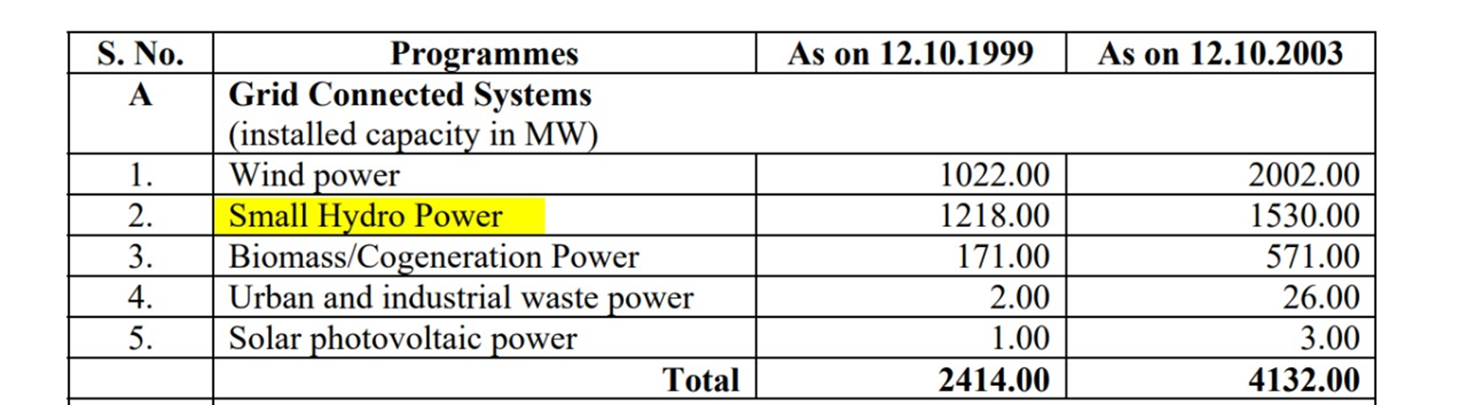
TARGET CUSTOMER AND MARKET POTENTIAL IN TERMS OF INR

Slide 10
IS IT ECONOMICALLY VIABLE?
One good practice could be to set up the MHP model with an integrated ownership model, this means that a private investor is responsible for the upfront-capital, the set up and the technical Operation and Maintenance of the MHP plant
A community committee responsible for tariff setting can also help to ensure that a tariff system is set up which allows for enough income to cover costs, maintenance and repairs, to offer reliable revenues for the private investor and to ensure that tariffs are still within the local range of willingness and ability to pay.
If MHP systems are grid-connected, a reliable and attractive feed-in-tariff is the best option to ensure the long-term financial viability of a MHP system.

Slide 11
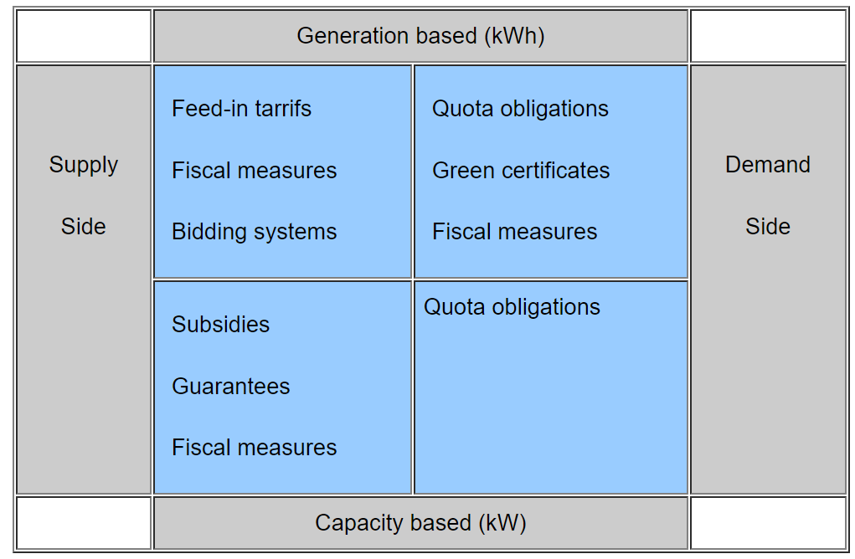
Promoting Micro Hydro Plants

Slide 12
NOVELTY OF OUR IDEA
Hydropower infrastructure plays a dual role in meeting the climate change challenge. It is the largest source of affordable renewable energy, and as a low-carbon fuel, plays a critical role in mitigating greenhouse gas emissions.
Increasing the share of hydro in the Indian energy mix from 24 to 35 percent, as proposed by the Indian government, will avoid 138 mt CO2 per year from alternative coal generation, equal to 8.5 percent of emissions in India in 2015.

Slide 13

APPLICABILITY OF SOLUTION

Slide 14
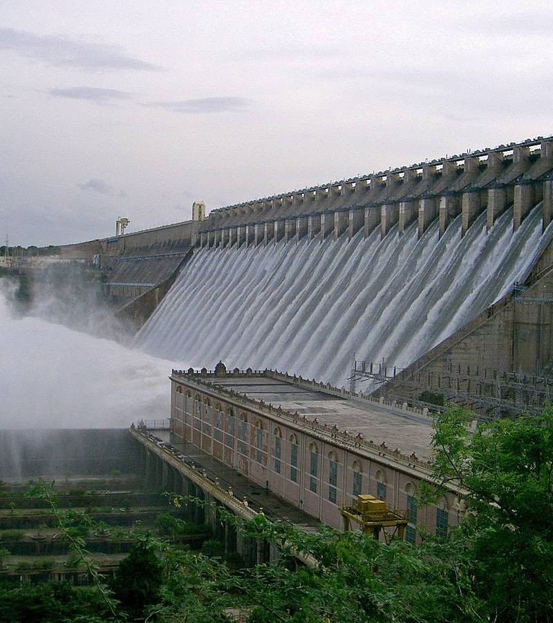
CONCLUSION
Hydroelectric power is a renewable energy source and contributes no greenhouse gases or other pollutants. Hydroelectric power plants can include a reservoir (generally created by a dam) to use the energy of falling water, or the kinetic energy of water as in run-of-the-river hydroelectricity.
International institutions such as the World Bank view hydropower as a means for economic development without adding substantial amounts of carbon to the atmosphere, which makes it one of the most effective methods of renewable energy.
Hydroelectric powerplants are the most efficient means of producing electric energy. The efficiency of today's hydroelectric plant is about 90 percent.

Slide 15
WE ARE OPEN FOR QUESTIONS

